Slide 1
Sprint #1 Review
IGVC

Slide 2
Sprint metrics
Item | Estimated Time | Actual Time
Vision, Mission, Success Criteria | 8 | 3
Background | 5 | 2
Related work | 2 | 1
System Overview | 2 | 1
Roles and Responsibilities | 3 | 2
Cost Proposal | 2 | 1
Facilities and Equipment | 2 | 2
Assumptions and constraints | 4 | 2
Risks | 5 | 2
Documentation and Reporting | 3 | 2
Total time | 25 | 18

Slide 3
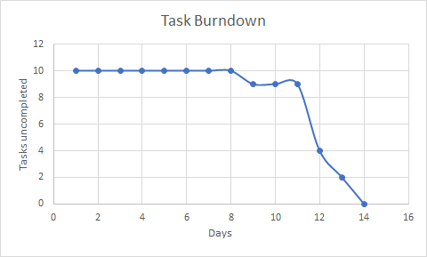
Sprint Metrics Continued

Slide 4
Vision
Our vision for this project is to design and construct an intelligent ground vehicle. With this vehicle we plan to go and compete in the International Ground Vehicle Competition (IGVC). Our goal is to qualify and win the competition.

Slide 5
System Overview
Computer Vision
Waypoint navigation
In bounds pathing
Data processing/ communication

Slide 6
Facilities and Equipment
Testing facilities
Robot Hardware
Robot Software

Slide 7
Assumptions and Constraints
Status of project after 4th sprint
Current resources and budget
IGVC Competition Guidelines

Slide 8
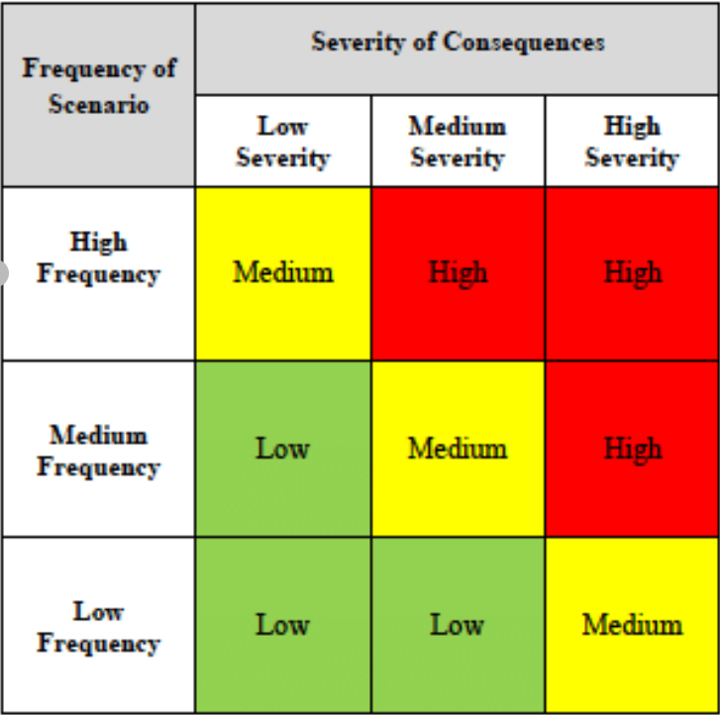
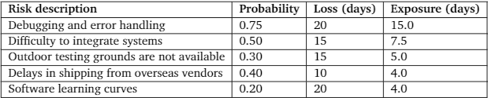
Risk
We determined some of the greatest risks to our project and classified them using the risk assessment matrix.We then assigned value to the risks based on their classification to determine the cost of these risks on our project.

Slide 9
Documentation and Reporting
As a team we took the initial steps to begin centralizing any items that might be created throughout the course of the project:
Code repositories: Team BitBucket
PCB design: Eagle
Moving forward, much of this section will be developed to include handling procedures for requirements, sprint protocol, and project specifications

Slide 10
Issues
Determining a team name.
Finding an area where we can test our intelligent ground vehicle.

